Slide 1

KMP-Based Mealy Machine Visualizer and String Matching Web Application
Group Members:
Javaria Owais (23FA-017-CS)
Sahir Ul Hassan (23FA-021-CS)

Slide 2
The Problem
We want to find a small word (pattern) inside a big word (text).
Example:
Text = ababcabac
Pattern = abac
We want to find where abac appears in the text.
Naive Algorithm (slow) | KMP Algorithm (smart)
Start matching from the beginning and if a mismatch happens, it starts again from the next character | It remembers what it has already matched; never goes backward. It uses LPS array for transitions
This wastes time because we recheck characters we already know | This saves time and avoid rechecking characters (more efficient)
Time complexity: O(n * m) | Time complexity: O(n + m)

Slide 3


LPS (Longest Prefix that is also Suffix) prefix: starting part of the string suffix: ending part of the string
Note: It cannot be the whole string lps = [0, 0, 1, 0]
Meaning: at index 2, ‘a’ matches the beginning ‘a’
Example pattern: abac
We calculate LPS for each position:
Index | Pattern | Prefix-Suffix Length
0 | a | 0
1 | b | 0
2 | a | 1
3 | c | 0

Slide 4
Working (1/2)
KMP as a Finite Automaton (FA)
Automaton Modeling
States: Represent number of matched characters of the pattern
States = {0, 1, 2, ..., m}
Valid Characters: {a, b} or {0, 1}
Start State: State 0 (no characters matched)
Accepting State: State m (full pattern matched)

Slide 5
Working (2/2)
KMP as a Finite Automaton (FA)
How We Build Transitions?
We do not use any Python’s built-in String Searching function or any external Automata library.
Transition function δ(state, input) is computed using:
      LPS Array
      On match → move to next state
      On mismatch → fall back using lps[state - 1]
      This simulates FA transitions efficiently

Slide 6
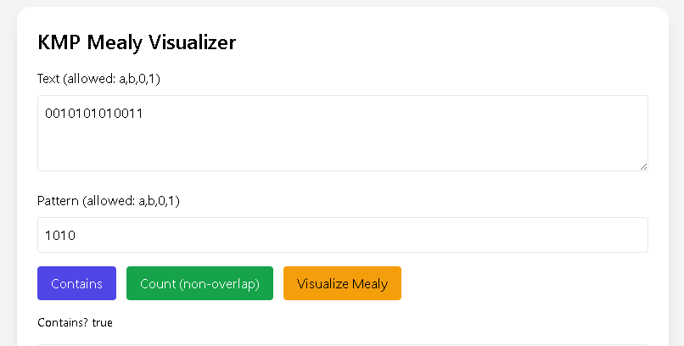
Implementation (1/2)
KMP as a Finite Automaton (FA)

Slide 7
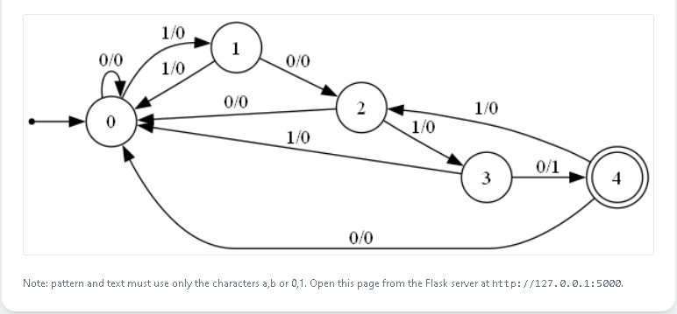
Implementation (2/2)
KMP as a Finite Automaton (FA)

Slide 8
Thankyou!

